Slide 1
VAST 2018 MC 1
James Johnson-Cowles Prasad Reddy Mucheli Aniruddha Purohit Ashrith Reddy Dodda Lohith Reddy Vanguru

Slide 2
Mini Challenge 1 Overview
Due to the Results of VAST 2017 it is suggested that Kasios Furniture manufacturing company is responsible for the decline in Rose-Chested Blue Pipits in the Boonsong Lekagul Nature Preserve. The Pangera Ornithology Conservation Society and the Kasios Furniture company have provided information on bird calls in the Lekagul Preserve.
James johnson -Cowell

Slide 3
Questions
Using the bird call collection and the included map of the Wildlife Preserve, characterize the patterns
of all of the bird species in the Preserve over the time of the collection. Please assume we have a reasonable distribution of sensors and human collectors providing the recordings, so that the patterns are reasonably representative of the bird locations across the area. Do you detect any trends or anomalies in the patterns?
Turn your attention to the set of bird calls supplied by Kasios. Does this set support the claim of Pipits being found across the Preserve? A machine learning approach using the bird call library may help your investigation. What is the role of visualization in your analysis of the Kasios bird calls?
Formulate a hypotheses concerning the state of the Rose Crested Blue Pipit. What are your primary pieces of evidence to support your assertion? What next steps should be taken in the investigation to either support or refute the Kasios claim that the Pipits are actually thriving across the Boonsong Lekagul Wildlife Preserve?

Slide 4
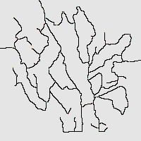
Map
Prasad Reddy Mucheli

Slide 5
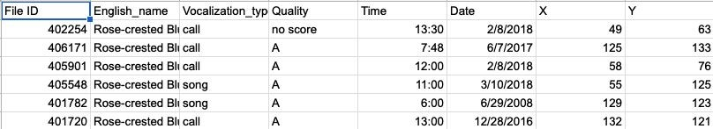
Dataset
Sensor Data of bird calls from 30+ years provided by Pangera Ornithology Conservation Society are formatted like this:
File ID: the index to the ﬁle names in the ALL BIRDS ﬁle collection.
English_name: the common English name for the particular bird.
Vocalization_type: the kind of bird sound it is: a call, a song, or some other particular sound.
Time and Date: Time and date of the captured bird noises.
X and Y: the coordinates on the map of where the sound was recorded.
Ashrith Reddy Dodda

Slide 6
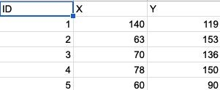
Dataset
Sensor Data of Rose-crested Blue Pipits calls provided by the Kasios company:
ID: Index of the locations of the calls
X and Y: the coordinates on the map of the sound recorded
Anirudha Purohit

Slide 7
Analysis Tool
Tableau
Excel
Python libraries
Lohith Reddy Vanguru

Slide 8
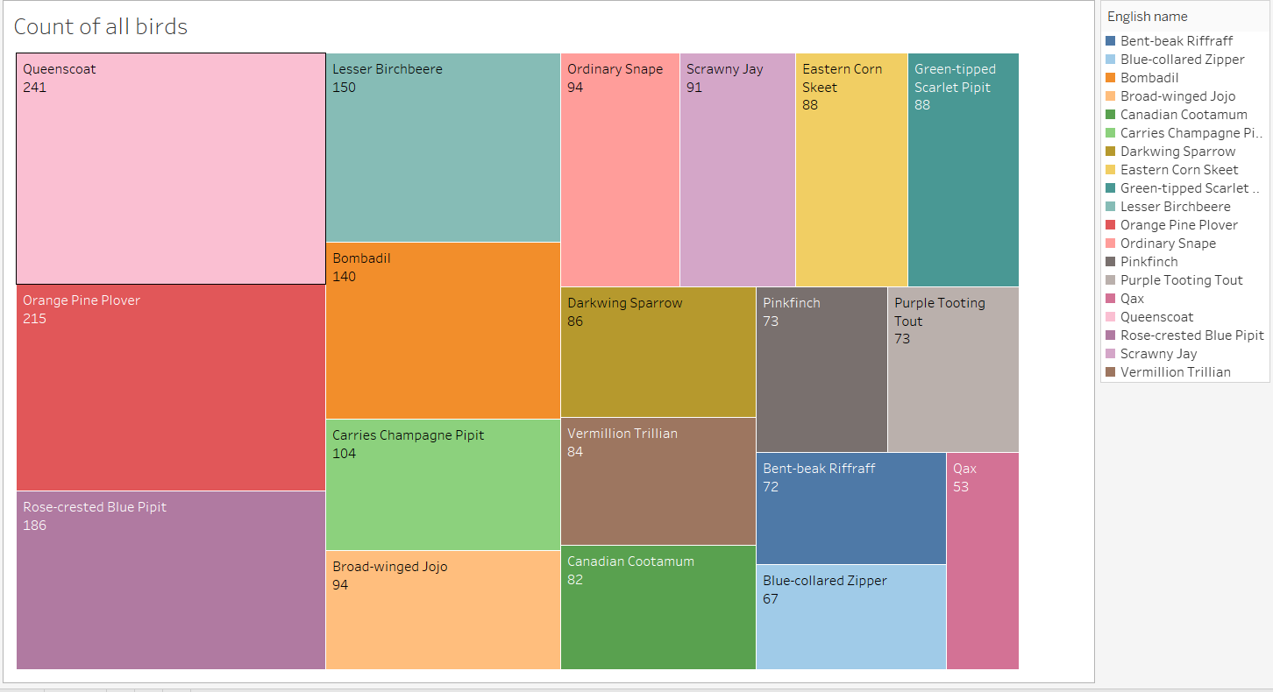
Analysing the data

Slide 9
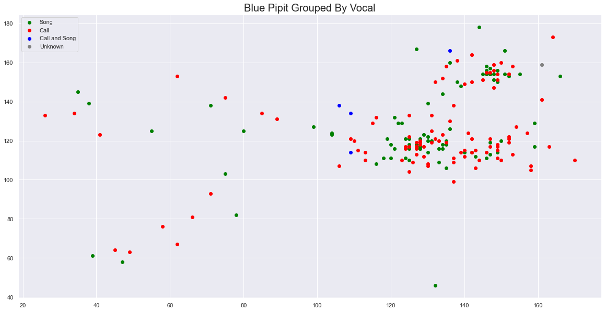
Blue pipit grouped by vocal

Slide 10
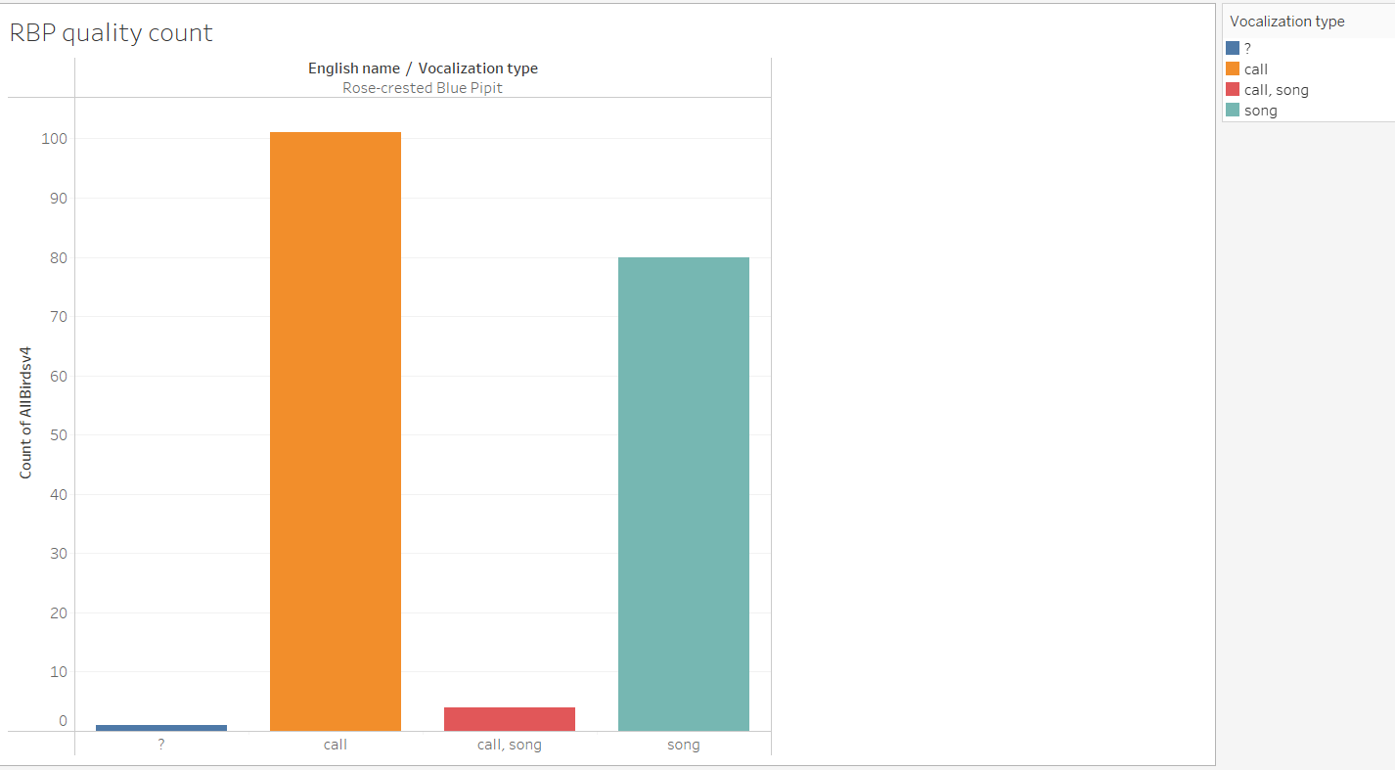
RBP birds song/quality count

Slide 11
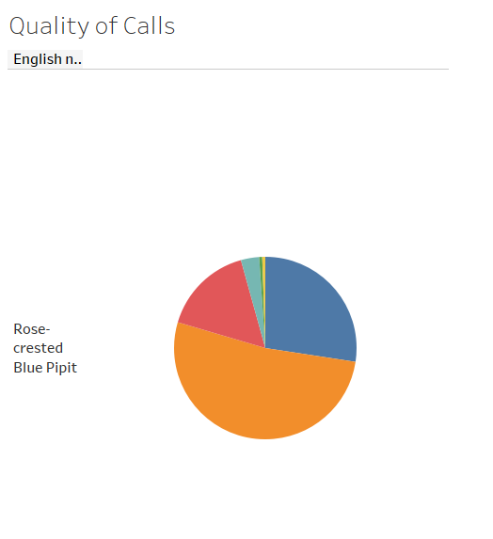
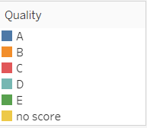
Quality comparison of calls/songs

Slide 12
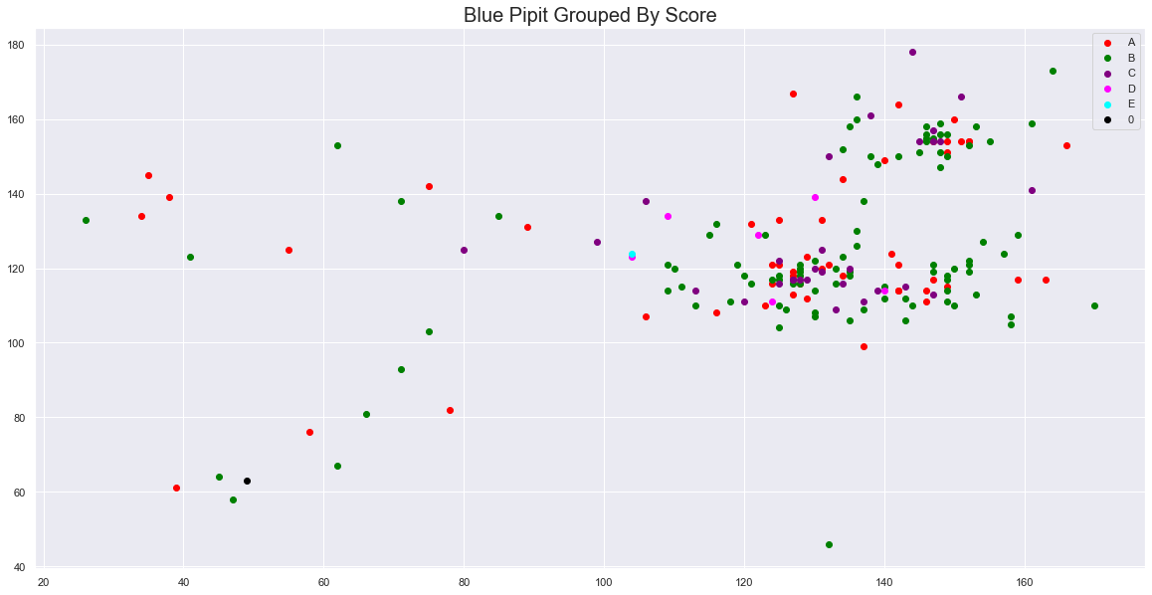
Blue pipits grouped by score

Slide 13
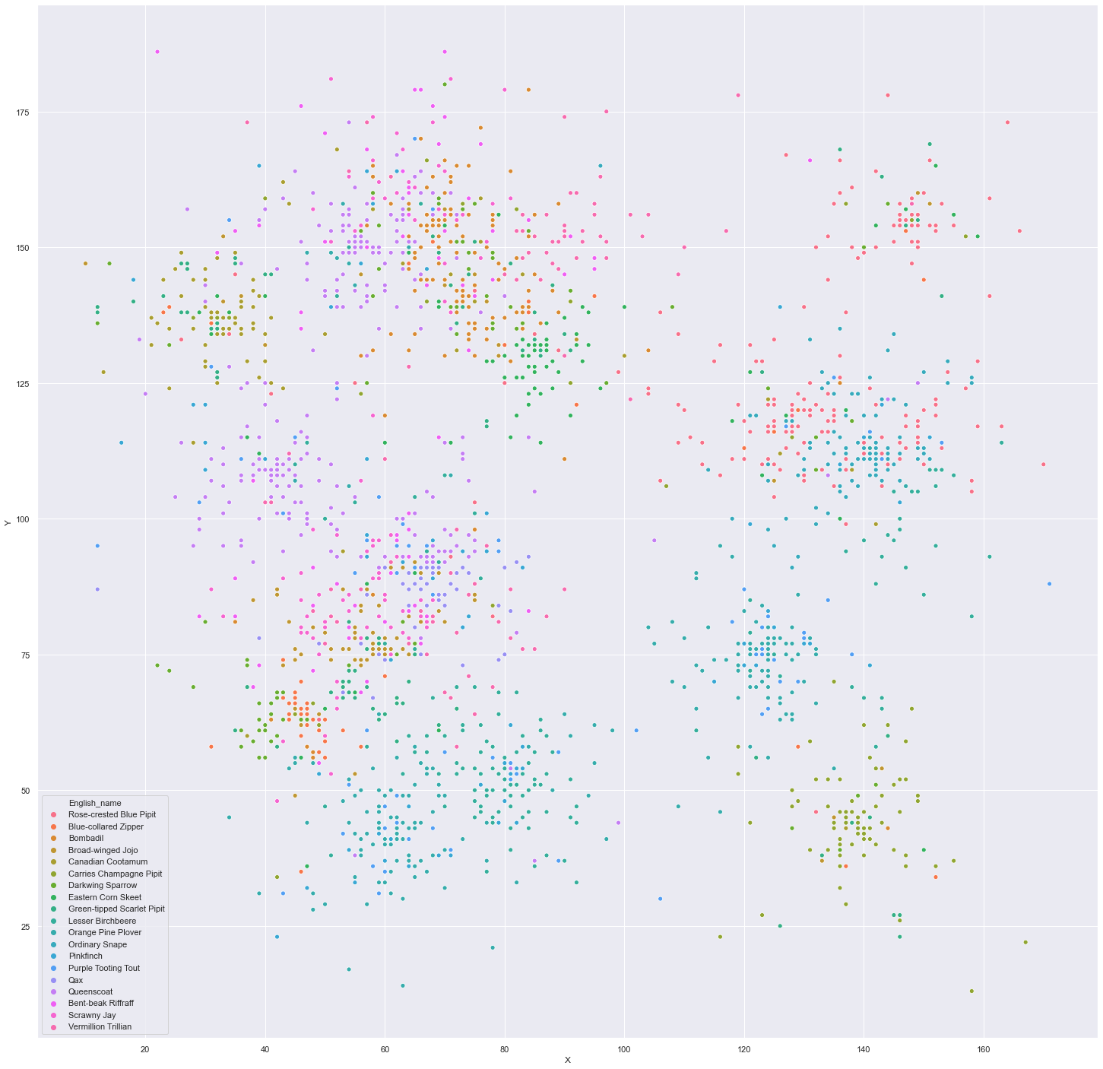
All birds scatter

Slide 14
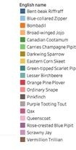
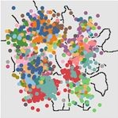
Map of Raw data on All Bird Calls
James Johnson -Cowell

Slide 15
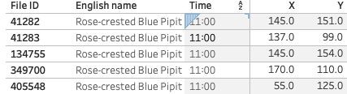
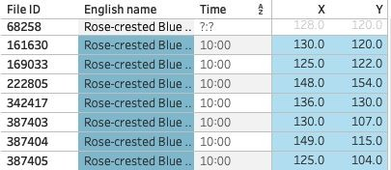
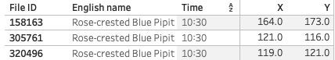
Question 1: Trends, Anomalies, Patterns?
Prasad Reddy Mucheli
A Trend that we noticed is that the same calls would be recorded at the same time, at around the same location.

Slide 16
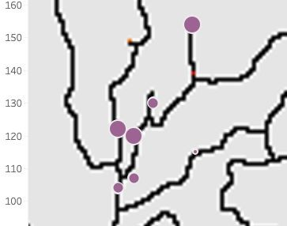
Question 1: Trends, Anomalies, Patterns?
Lohith Reddy Vanguru
So we ﬁltered a map by quality to see if they were getting the same calls just at different qualities. It is this way due to the distance from the call itself.

Slide 17
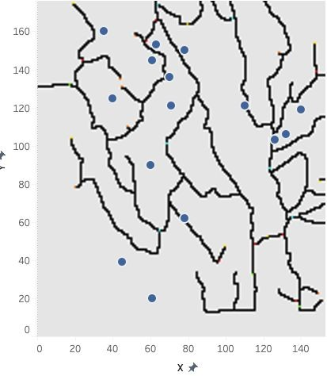
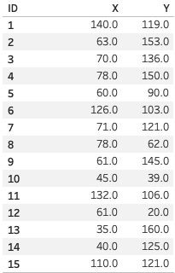
Question 2: Pipits everywhere?
Ashrith Reddy Dodda
Bird sound data supplied by Kasios we also decided to map it out. With this data the claim that Rose-chested Blue Pipits are everywhere on the Preserve.
This is all they data they gave us.

Slide 18
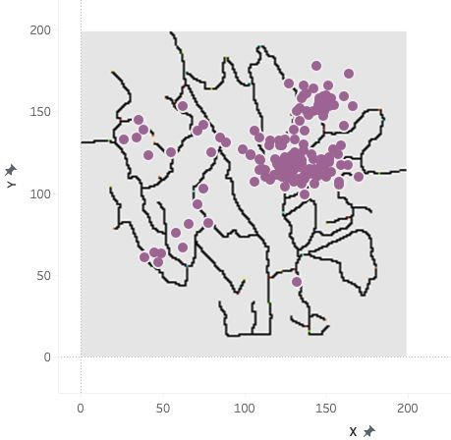
Question 2: Pipits everywhere?
James Johnson - Cowell
We compared this with our map of Rose chested Blue Pipit map to see any differences.
The circled dots don’t show up at all on our map of them so its possible the picked up something else

Slide 19
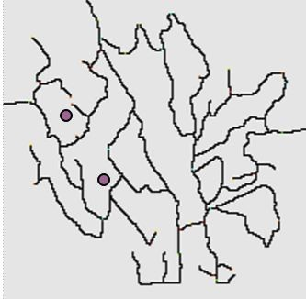
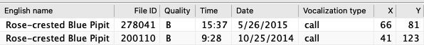
Question 2: Pipits everywhere?
Aniruddha Purohit
We also checked the ones we knew matched up by date.
Their dates were about 7 months apart.

Slide 20
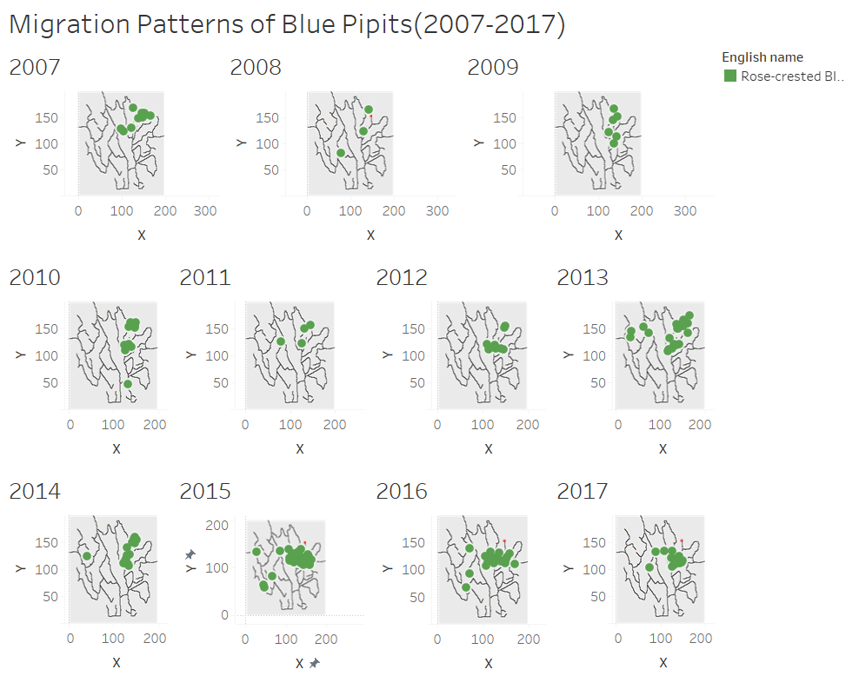
X and Y are the Co ordinates given in the Dataset
Migration Patterns of Rose-crested blue pipits over the decade from 2007 till 2017

Slide 21
Migration Patterns of Rose-crested blue pipits over the decade from 2007 till 2017

Slide 22
Above three slides depicts that blue pipits are gradually moving away from the dumping site in the span of decade from 2007 to 2017.

Slide 23
Recording of Rose-crested blue pipits in the last few months

Slide 24
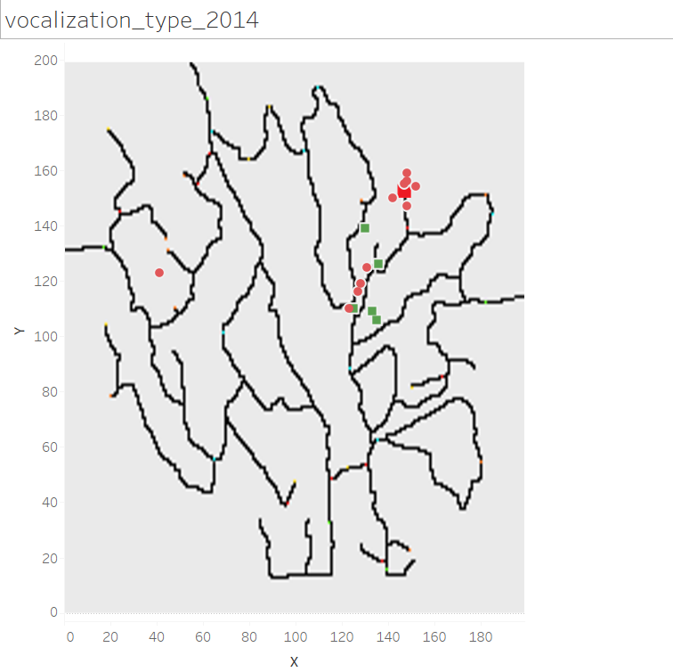
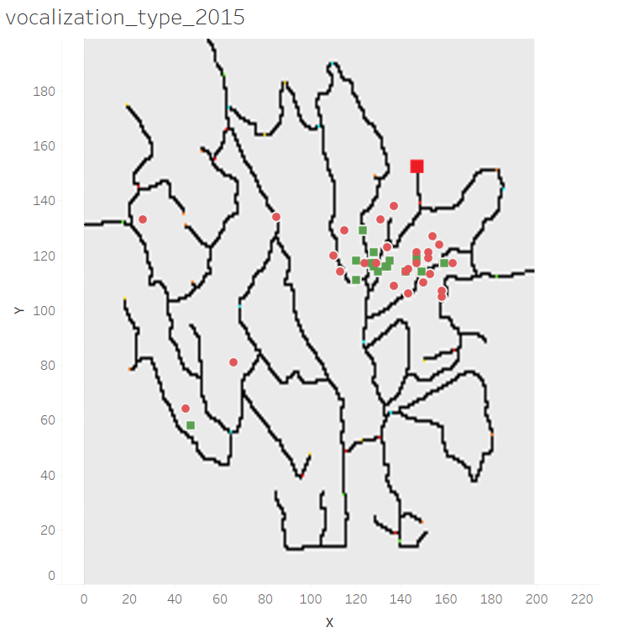
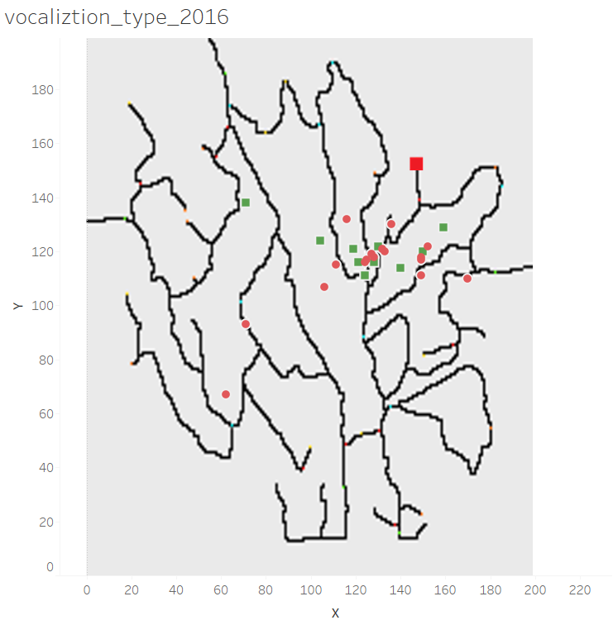
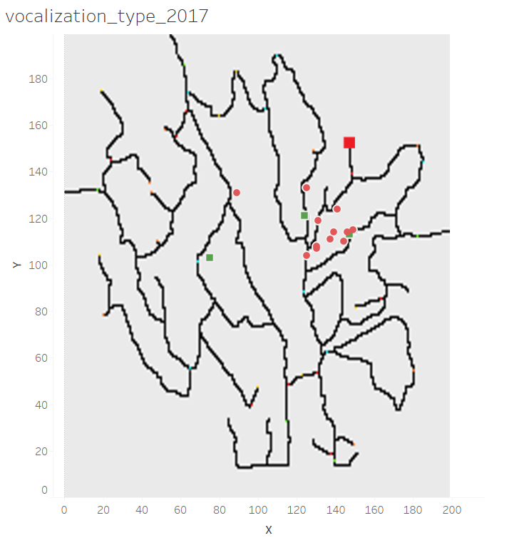
Analysis of Bird Call's And Song's(2013-2017)

Slide 25
Objective for 2nd progress
Kasios claims that Rose-crested blue pipits are spotted around the dumping region
Audio Recoding are provided as evidence by the company
Are the calls really heard? Is the claim valid?
Machine Learning model to analyse calls

Slide 26
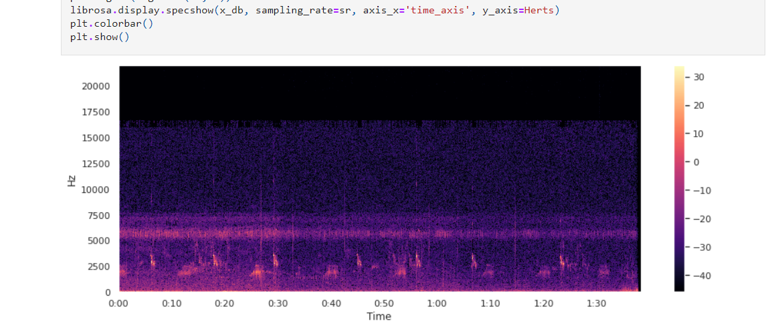
Test data extracting spectrograms
Spectrograms were plotted for each and every test data

Slide 27
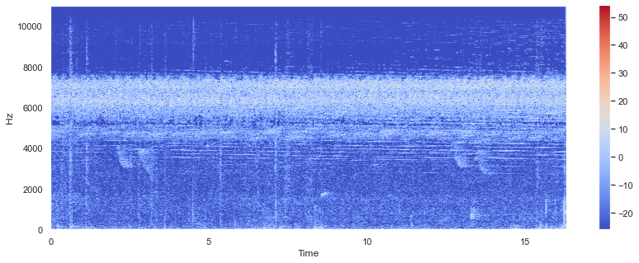
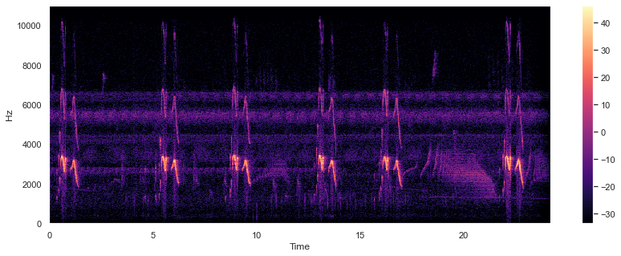

Slide 28
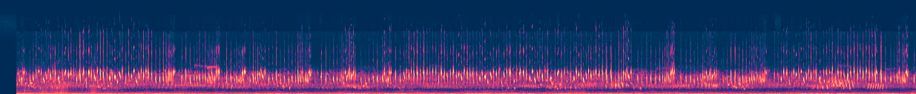
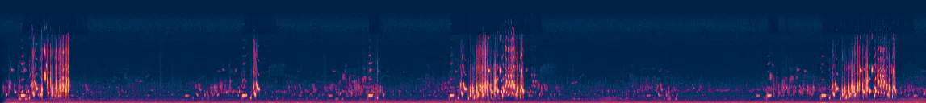
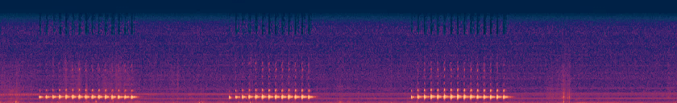
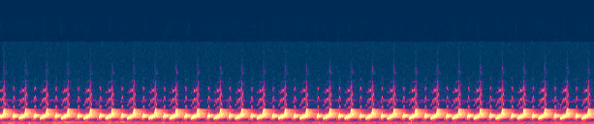
Audio sets given by Kasios are used as test data:
1.mp3
2.mp3
3.mp3
4.mp3
5.mp3
6.mp3
8.mp3
7.mp3

Slide 29
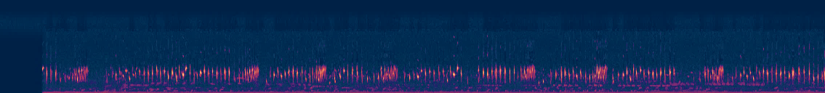
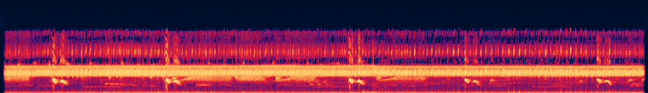
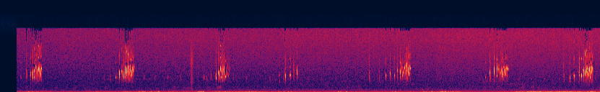
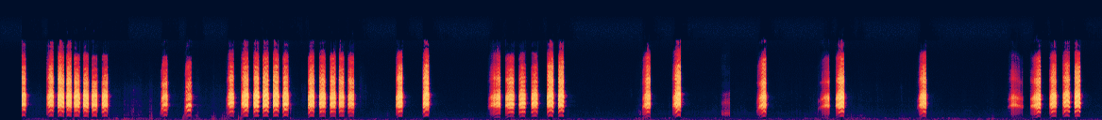
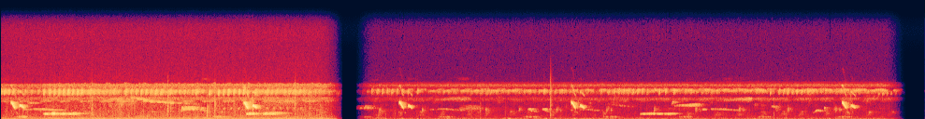
9.mp3
10.mp3
11.mp3
12.mp3
13.mp3
14.mp3
15.mp3

Slide 30
Training dataset
Dataset consists of audio files of all birds
2081 files

Slide 31
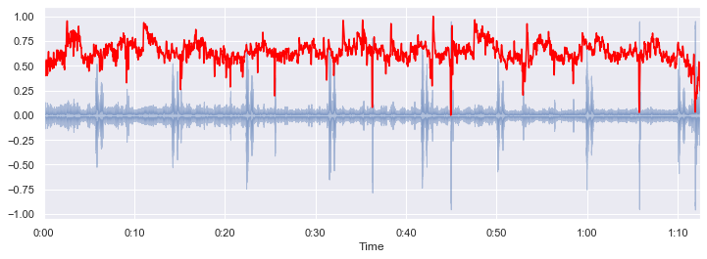
Extracting features
Complexity based features are used for feature extraction and classification of EEG data.
Spectral centroid: Special feature of librosa that indicates centre of mass of the spectrum is located.

Slide 32
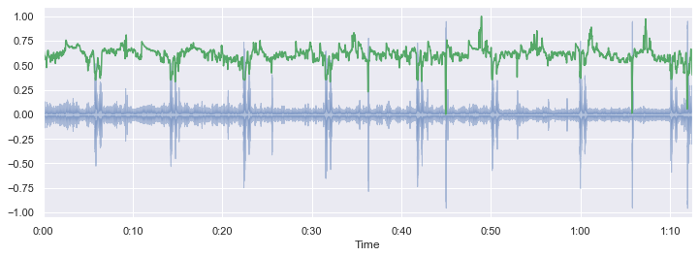
Spectral roll-of:
Roll-off frequency is defined as the frequency under which some percentage (cut-off) of the total energy of the spectrum is contained.
roll-off frequency can be used to distinguish between true sounds and noisy sounds
Correlating values at time instances

Slide 33
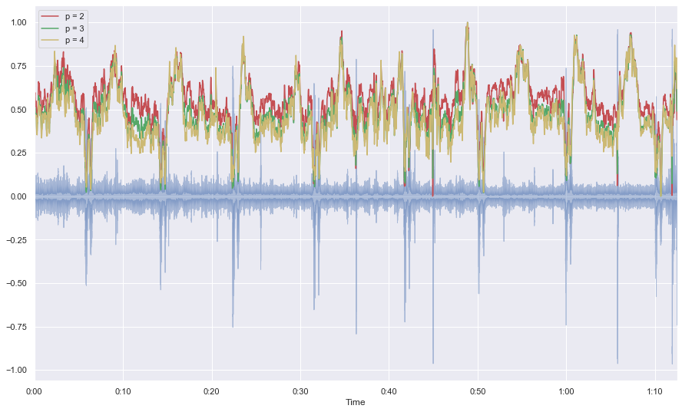
Spectral bandwidth: p is the power in dB

Slide 34
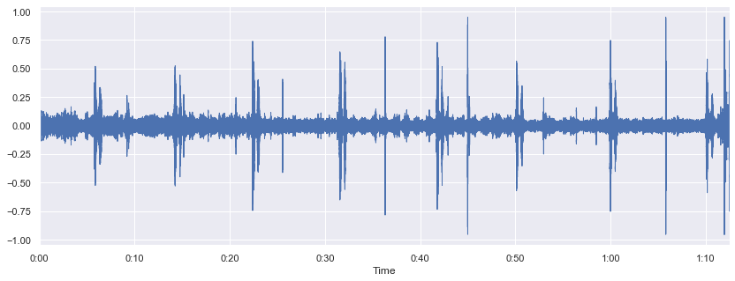
Zero crossing rate: Amount at which a signal changes its sign during the frame from positive to negative and vice versa, divided by the total length of the frame.

Slide 35
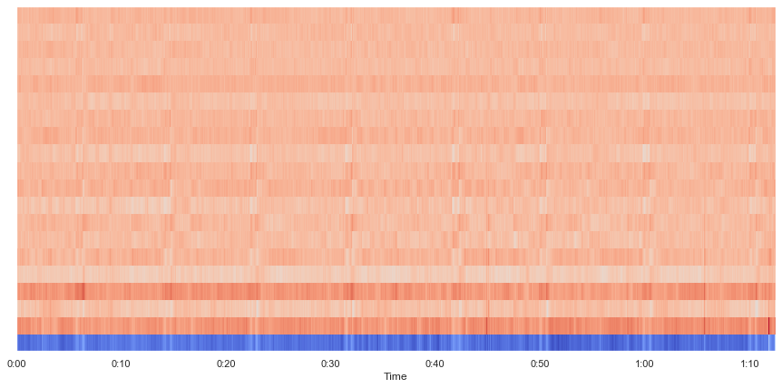
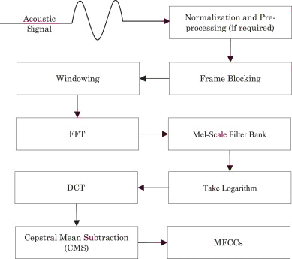
MFCC: Mel-frequency cepstrum is a representation of the short-term power spectrum of a sound, based on a linear cosine transform of a log power spectrum on a nonlinear mel scale of frequency

Slide 36
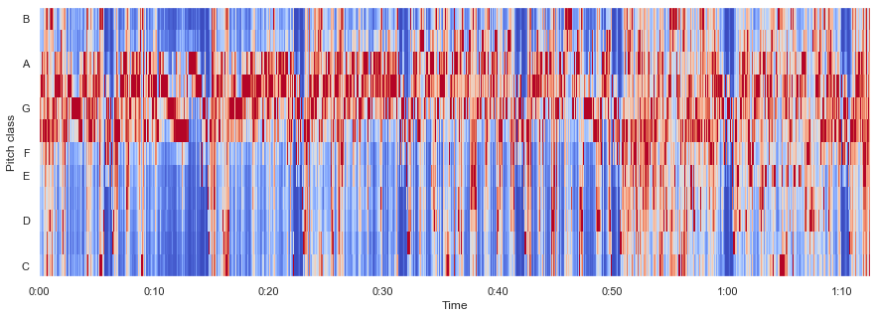
Chromogram: Identifying pitches that differ by an octave, chroma features show a high degree of robustness to variations in timbre and closely correlate to the musical aspect of harmony.

Slide 37
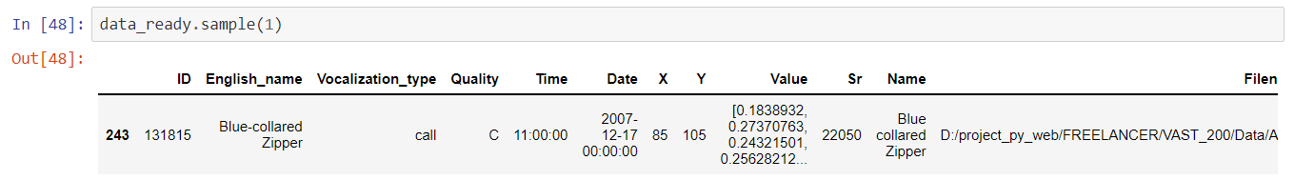
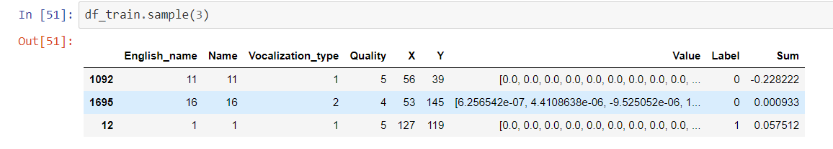
Feature engineering
ID: File ID number
Value: amplitude/frequency values extracted from the spectrogram
Filename: Training file name

Slide 38
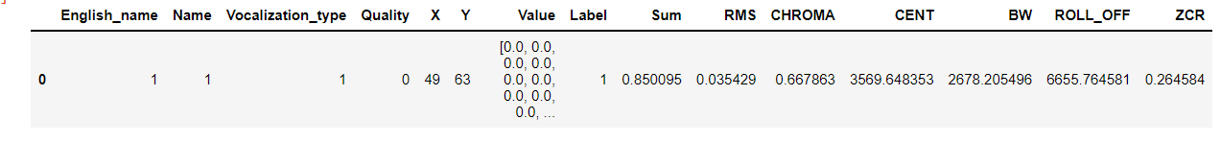
Root-mean square error: RMS amplitude format is calculated by squaring the peak amplitude of the wave, diving it by two, and then taking the square root of that quantity
Short-time Fourier of the chromogram: Audio structure analysis or content-based audio retrieval
Spectral centroid: Indicates the centroid in the audio in frequency domain
Spectrum bandwidth: Range of frequencies available in the audio file
Spectral roll-off: Segregates the noise from the line of interest
Zero crossing rate: Deviation of the frequency line from zero

Slide 39
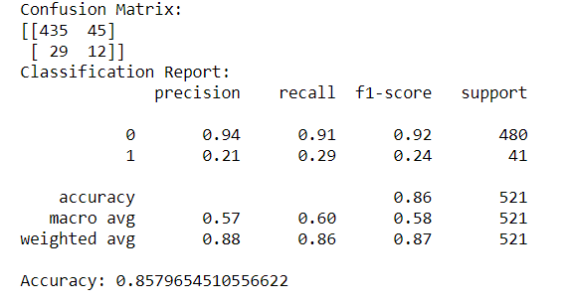
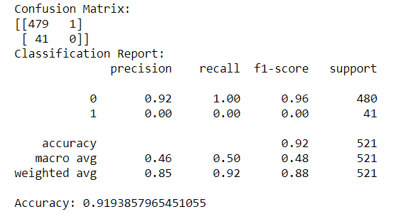
Implementing ML models
Decision tree:
kNN

Slide 40

SVM:

Slide 41

Results and conclusion
All the models performed well on training dataset
Only 2 class labels were found in the data which matched the Rose-crested blue pipits calls.
None of the other test audio really did contain blue pipits calls
Kasios claim is hence proved to be false from the gathered evidence

Slide 42
Final thoughts
Concerning the state of the Rose-Crested Blue Pipit within the Boonsong Lekagul Wildlife Preserve, the population is both decreasing and moving away from the alleged Kasios dumping site.
This assertion is supported primarily by the trends in recording samples provided by the Wildlife Preserve.
Additionally, the Kasios sponsored investigation to prove the Rose-Crested Blue Pipit is still thriving is not reliable, as indicated by our analysis.

Slide 43
Additional steps - Further investigation.
Better independent data gathering.
Quality of recordings was a major issue.
Pollution detections (sensors out in the field)

Slide 44

Visualization using d3 JavaScript library

Slide 45


Slide 46
References
Theodoros Giannakopoulos, Aggelos Pikrakis;Chapter 4 - Audio Features,
Introduction to Audio Analysis; Academic Press; 2014; Pages 59-103; ISBN 9780080993881; (https://www.sciencedirect.com/science/article/pii/B9780080993881000042)

Slide 47
Thank you

